Slide 1


Objectives
In this session, you will learn to:
Introduction to Bootstrap
Elements in Bootstrap
Applying Bootstrap in website

Slide 2
What is Bootstrap?
Bootstrap is a free front-end framework for faster and easier web development
Bootstrap includes HTML and CSS based design templates for typography, forms, buttons, tables, navigation, modals, image carousels and many other, as well as optional JavaScript plugins
Bootstrap also gives you the ability to easily create responsive designs
Responsive web design
Process that creating web sites which automatically adjust themselves to look good on all devices, from small phones to large desktops.

Slide 3
Why Use Bootstrap ?
Advantages of Bootstrap:
Easy to use: Anybody with just basic knowledge of HTML and CSS can start using Bootstrap
Responsive features: Bootstrap's responsive CSS adjusts to phones, tablets, and desktops
Mobile-first approach: In Bootstrap 3, mobile-first styles are part of the core framework
Browser compatibility: Bootstrap is compatible with all modern browsers (Chrome, Firefox, Internet Explorer, Safari, and Opera)

Slide 4
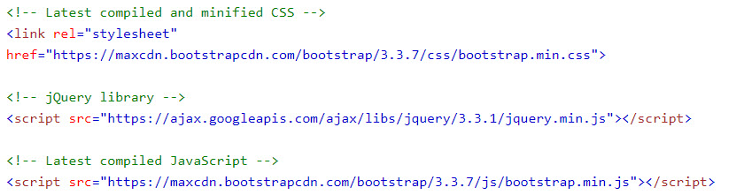
Where to Get Bootstrap ?
There are two ways to start using Bootstrap on your own web site.
Include Bootstrap from a CDN
If you don't want to download and host Bootstrap 4 yourself, you can include it from a CDN (Content Delivery Network).
Download Bootstrap from getbootstrap.com

Slide 5
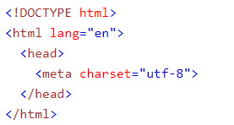
Create First Web Page With Bootstrap
Add the HTML5 doctype
Bootstrap uses HTML elements and CSS properties that require the HTML5 doctype.
Always include the HTML5 doctype at the beginning of the page, along with the lang attribute and the correct character set

Slide 6
Create First Web Page With Bootstrap
Bootstrap is mobile-first
Bootstrap is designed to be responsive to mobile devices. Mobile-first styles are part of the core framework.
To ensure proper rendering and touch zooming, add the following <meta> tag inside the <head> element.
The width=device-width part sets the width of the page to follow the screen-width of the device (which will vary depending on the device).
The initial-scale=1 part sets the initial zoom level when the page is first loaded by the browser.

Slide 7

Create First Web Page With Bootstrap
Containers
Bootstrap also requires a containing element to wrap site contents.
There are two container classes to choose from:
The .container class provides a responsive fixed width container
The .container-fluid class provides a full width container, spanning the entire width of the viewport

Slide 8
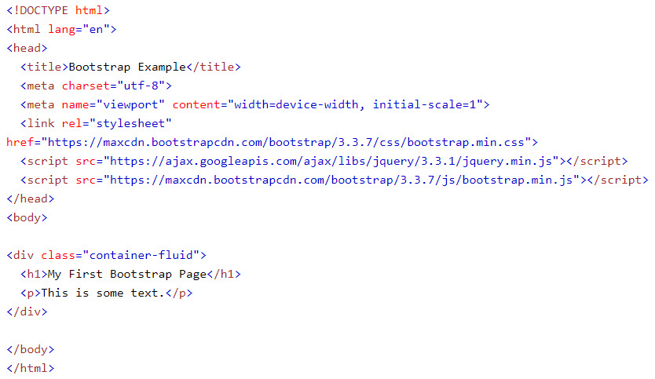
Demo
Example of container-fluid:

Slide 9
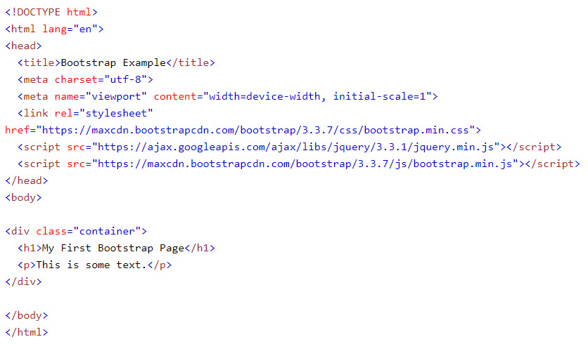
Demo
Example of container:

Slide 10
Bootstrap Grid System
Bootstrap's grid system allows up to 12 columns across the page.
If you do not want to use all 12 columns individually, you can group the columns together to create wider columns:
Bootstrap's grid system is responsive, and the columns will re-arrange automatically depending on the screen size.

Slide 11
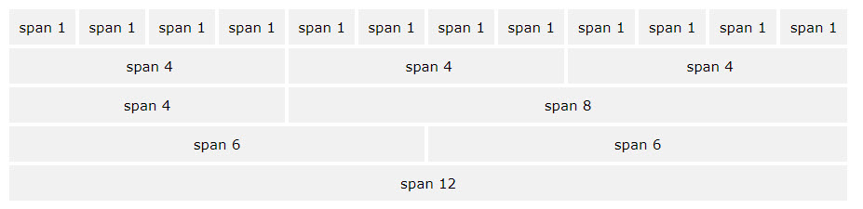
Bootstrap Grid System

Slide 12
Grid Classes
The Bootstrap grid system has four classes:
xs (for phones - screens less than 768px wide)
sm (for tablets - screens equal to or greater than 768px wide)
md (for small laptops - screens equal to or greater than 992px wide)
lg (for laptops and desktops - screens equal to or greater than 1200px wide)
The classes above can be combined to create more dynamic and flexible layouts.

Slide 13
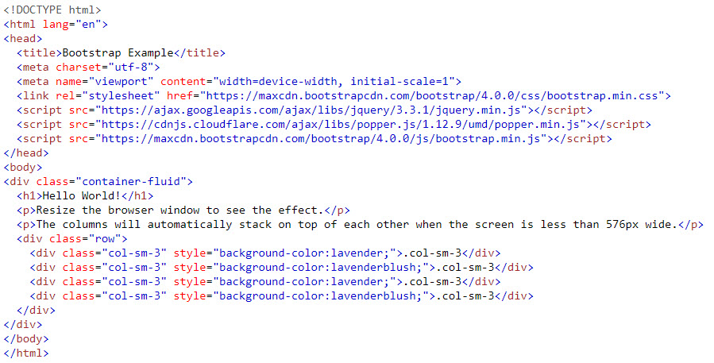
Responsive Columns

Slide 14
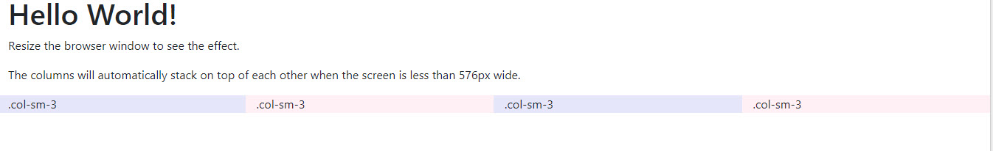
Responsive Columns
Output:

Slide 15
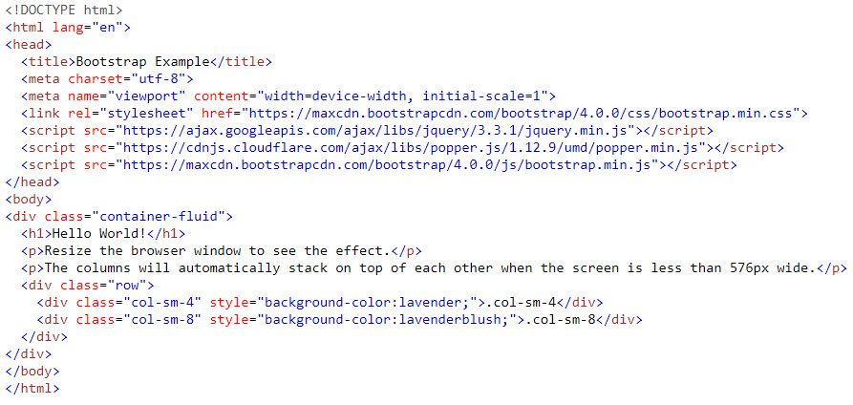
Two Unequal Responsive Columns

Slide 16
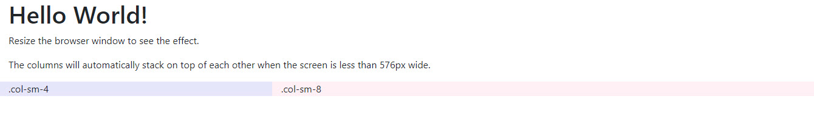
Two Unequal Responsive Columns
Output:

Slide 17
Bootstrap Text/Typography
Bootstrap Default Settings
Bootstrap's global default font-size is 14px, with a line-height of 1.428.
This is applied to the <body> element and all paragraphs (<p>).
In addition, all <p> elements have a bottom margin that equals half their computed line-height (10px by default).

Slide 18
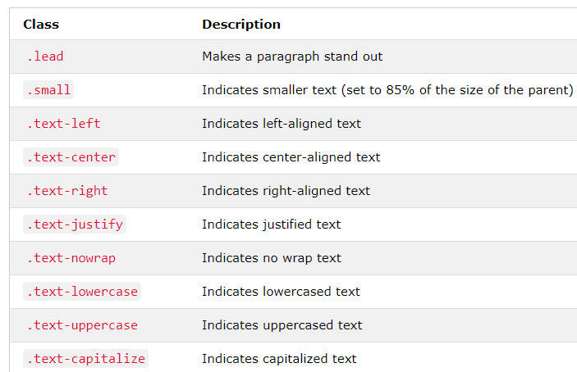
Bootstrap Text/Typography
More Typography Classes

Slide 19
Bootstrap Tables
A basic Bootstrap table has a light padding and only horizontal dividers.
The .table class adds basic styling to a table.
The .table-striped class adds zebra-stripes to a table
The .table-bordered class adds borders on all sides of the table and cells.
The .table-hover class adds a hover effect (grey background color) on table rows.
The .table-condensed class makes a table more compact by cutting cell padding in half.

Slide 20
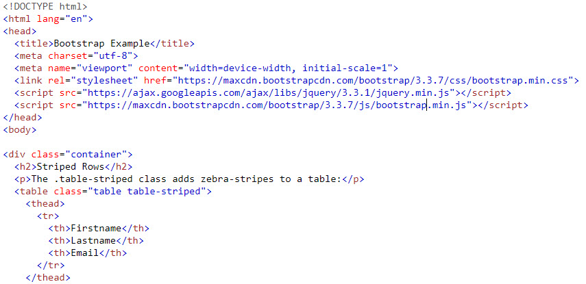
Bootstrap Tables
Example:

Slide 21
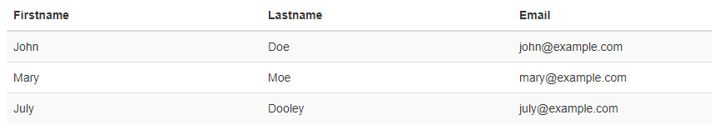
Bootstrap Tables
Output:

Slide 22
Bootstrap Images
The .img-rounded class adds rounded corners to an image (IE8 does not support rounded corners)
The .img-circle class shapes the image to a circle (IE8 does not support rounded corners)
The .img-thumbnail class shapes the image to a thumbnail
Create responsive images by adding an .img-responsive class to the <img> tag. The image will then scale nicely to the parent element.

Slide 23
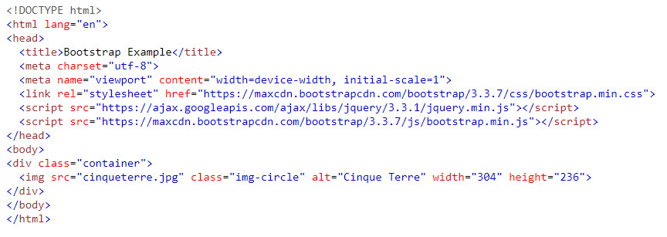
Bootstrap Images
Example:

Slide 24

Bootstrap Images
Output:

Slide 25
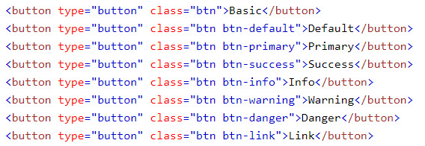
Bootstrap Buttons
Button Styles
Bootstrap provides different styles of buttons.
To achieve the button styles above, Bootstrap has the following classes:
Output:

Slide 26
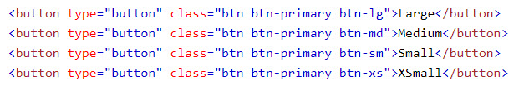

Bootstrap Buttons
Button Sizes
Bootstrap provides four button sizes.
Output:

Slide 27
Bootstrap Buttons
Block Level Buttons
A block level button spans the entire width of the parent element.
Add class .btn-block to create a block level button.
Active/Disabled Buttons
A button can be set to an active (appear pressed) or a disabled (unclickable) state.
The class .active makes a button appear pressed, and the class .disabled makes a button unclickable

Slide 28

Bootstrap Navigation Bar
A navigation bar is a navigation header that is placed at the top of the page.
With Bootstrap, a navigation bar can extend or collapse, depending on the screen size.
A standard navigation bar is created with <nav class="navbar navbar-default">.
If you don't like the style of the default navigation bar, Bootstrap provides an alternative, black navbar, you can change the .navbar-default class into .navbar-inverse
The .navbar-right class is used to right-align navigation bar buttons.

Slide 29
Bootstrap Navigation Bar
To add buttons inside the navbar, add the .navbar-btn class on a Bootstrap button.
To add form elements inside the navbar, add the .navbar-form class to a form element and add an input(s). Note that we have added a .form-group class to the div container holding the input.
The .navbar-fixed-top class makes the navigation bar fixed at the top.
The navigation bar often takes up too much space on a small screen. We should hide the navigation bar; and only show it when it is needed.

Slide 30
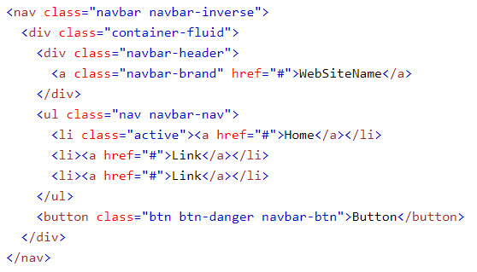

Bootstrap Navigation Bar
Demo:
Output:

Slide 31
Summary
Introduction to Bootstrap
Elements in Bootstrap
Applying Bootstrap in website

